Slide 1

© 2007 Prentice Hall, Inc. All rights reserved.
9–<number>

Slide 2
Environmental Scanning
  PESTEL & Porter analysis
  Competitor Intelligence
      information from employees, customers, suppliers, the Internet, and competitors themselves.
  Global Scanning
© 2007 Prentice Hall, Inc. All rights reserved.
9–<number>

Slide 3

Forecasting
  The part of organizational planning that involves creating predictions of outcomes based on information gathered by environmental scanning.
    Facilitates managerial
    decision making.
    Is most accurate in
    stable environments.
© 2007 Prentice Hall, Inc. All rights reserved.
9–<number>

Slide 4
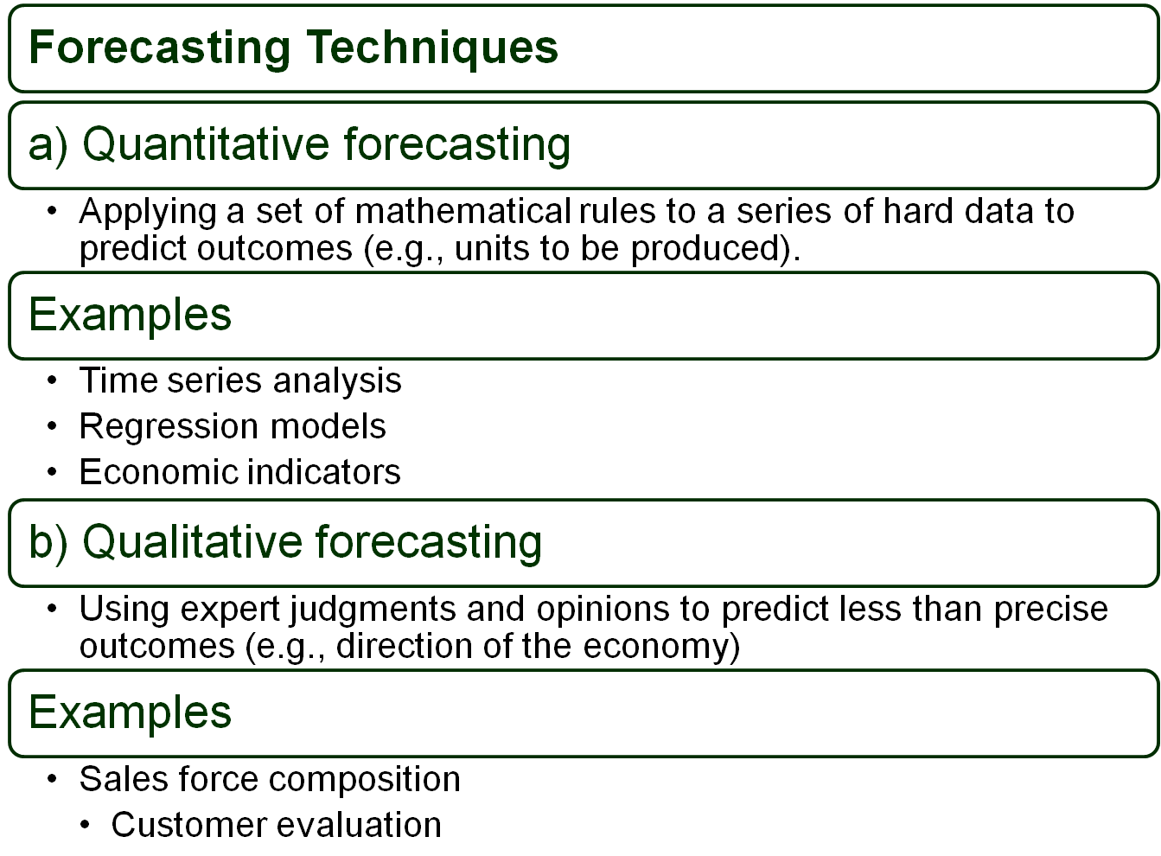
9–<number>

Slide 5

Benchmarking
The search for the best practices among competitors and noncompetitors that lead to their superior performance.
By analyzing and copying these practices, firms can improve their performance.
© 2007 Prentice Hall, Inc. All rights reserved.
9–<number>

Slide 6
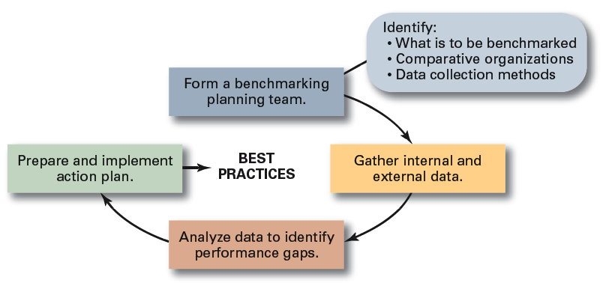
Exhibit 9–2 Steps in Benchmarking
Source: Based on Y.K. Shetty, “Aiming High: Competitive Benchmarking for Superior Performance,” Long Range Planning. February 1993, p. 42.
© 2007 Prentice Hall, Inc. All rights reserved.
9–<number>

Slide 7

Types of Resources
    Financial: debt, equity, and retained earnings
    Physical: buildings, equipment, and raw materials
    Human: experiences, skills, knowledge, and competencies
    Intangible: brand names, patents, reputation, trademarks, copyrights, and databases
© 2007 Prentice Hall, Inc. All rights reserved.
9–<number>

Slide 8


  Are numerical plans for allocating resources (e.g., revenues, expenses, and capital expenditures).
  most commonly& widely applicable
  planning technique
© 2007 Prentice Hall, Inc. All rights reserved.
9–<number>

Slide 9
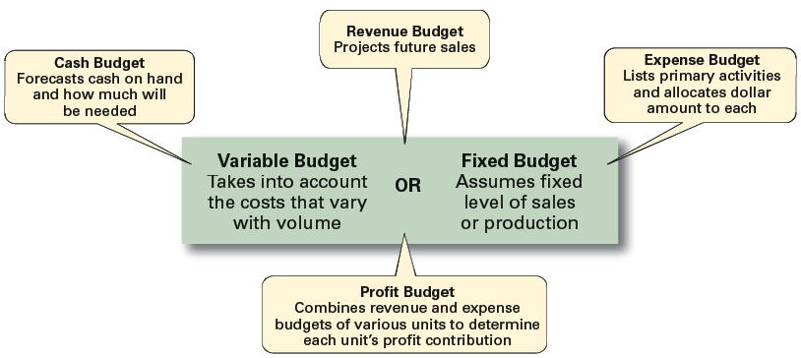
Exhibit 9–3 Types of Budgets
Source: Based on R.S. Russell and B.W. Taylor III. Production and Operations Management (Upper Saddle River, NJ: Prentice Hall, 1995), p. 287.
© 2007 Prentice Hall, Inc. All rights reserved.
9–<number>

Slide 10


  detailing what activities have to be done, the order in which they are to be completed, who is to do each, and when they are to be completed.
  Represent the coordination of various activities.
© 2007 Prentice Hall, Inc. All rights reserved.
9–<number>

Slide 11

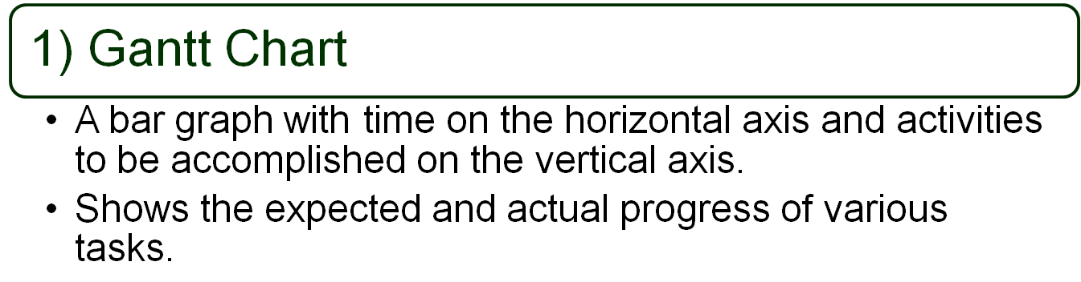
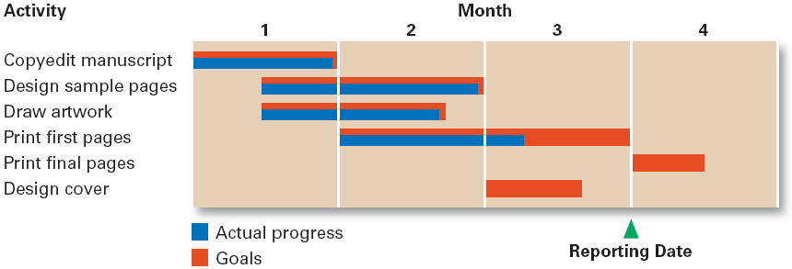
9–<number>

Slide 12
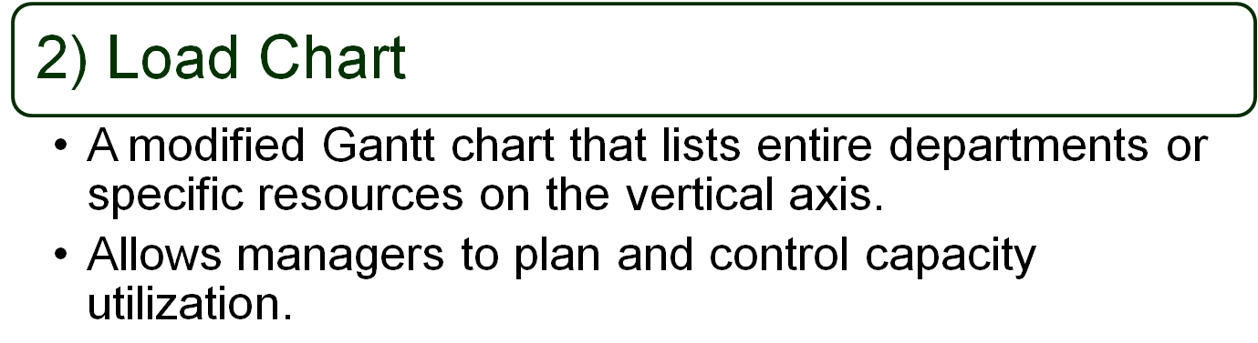
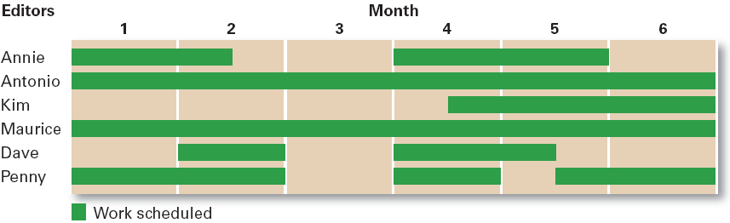
© 2007 Prentice Hall, Inc. All rights reserved.
9–<number>

Slide 13

© 2007 Prentice Hall, Inc. All rights reserved.
9–<number>

Slide 14
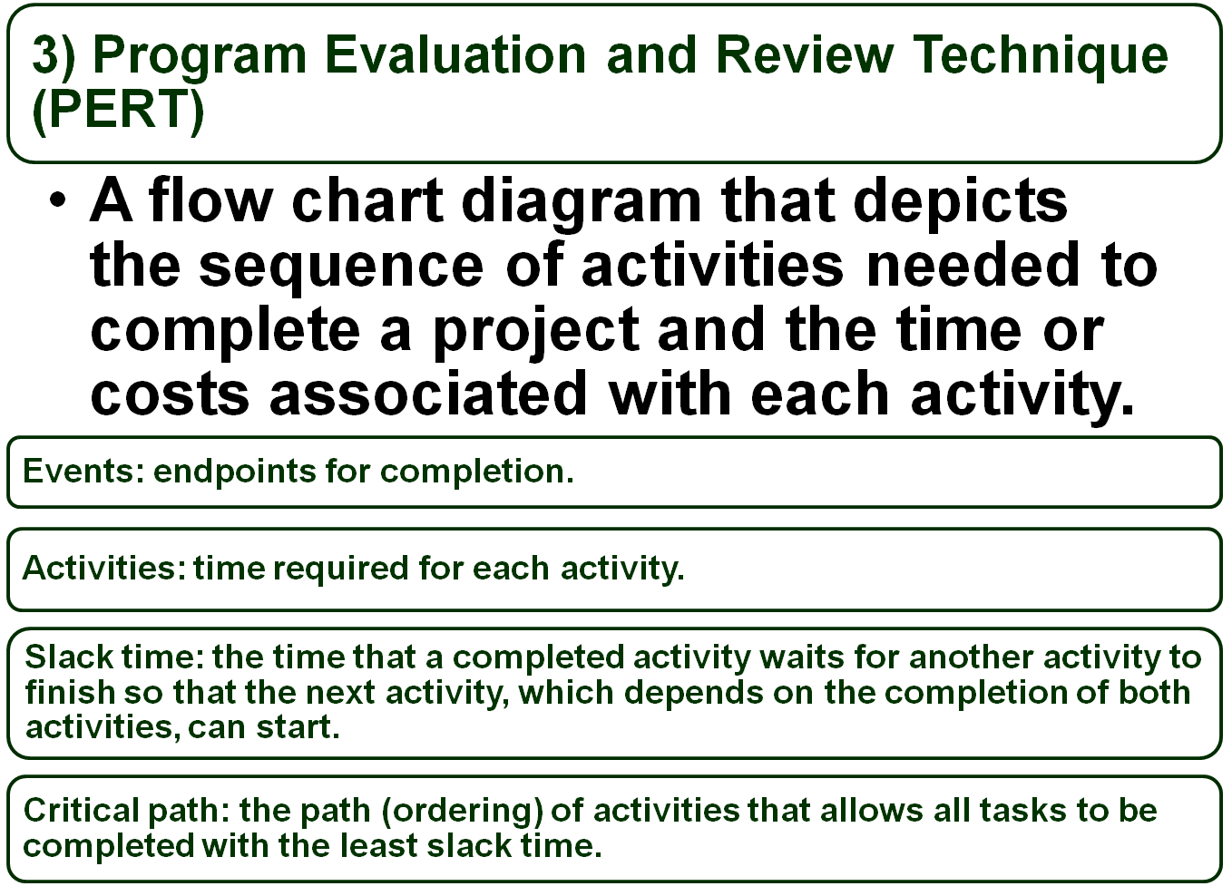
© 2007 Prentice Hall, Inc. All rights reserved.
9–<number>

Slide 15
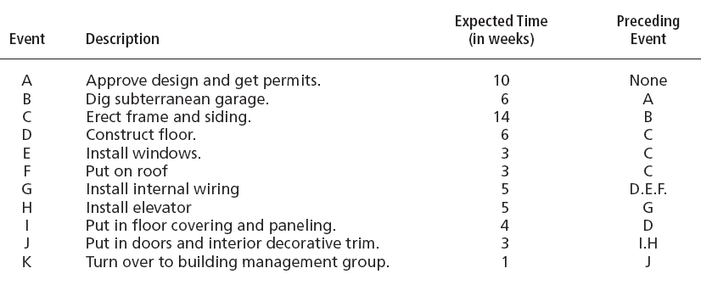
Exhibit 9–8 Events and Activities in Constructing an Office Building
© 2007 Prentice Hall, Inc. All rights reserved.
9–<number>

Slide 16
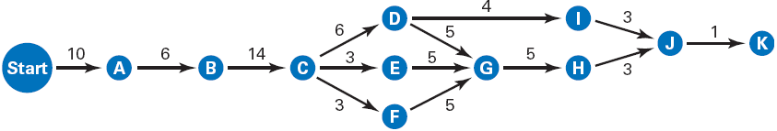
Exhibit 9–9 A Visual PERT Network for Constructing an Office Building
Critical Path: A - B - C - D - G - H - J - K
© 2007 Prentice Hall, Inc. All rights reserved.
9–<number>

Slide 17
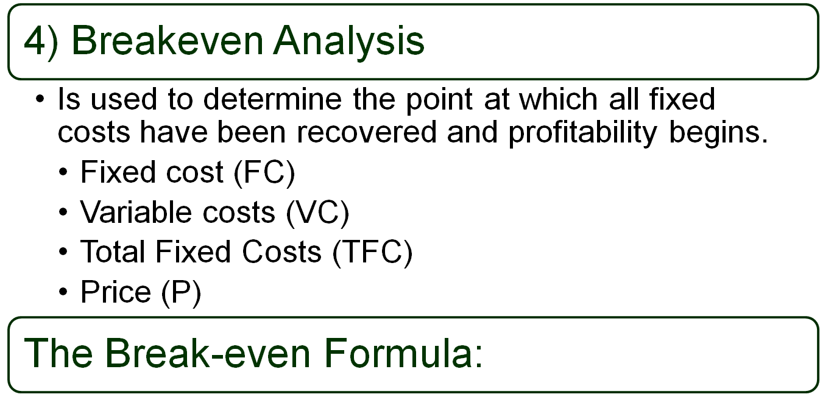

© 2007 Prentice Hall, Inc. All rights reserved.
9–<number>

Slide 18
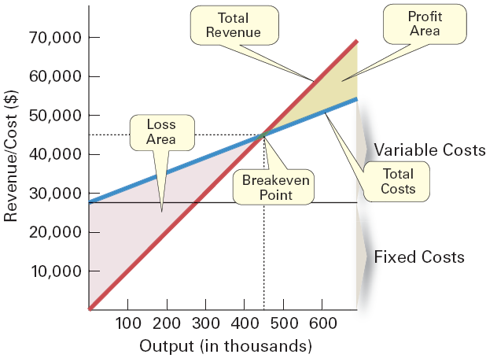
Exhibit 9–10 Breakeven Analysis
© 2007 Prentice Hall, Inc. All rights reserved.
9–<number>

Slide 19
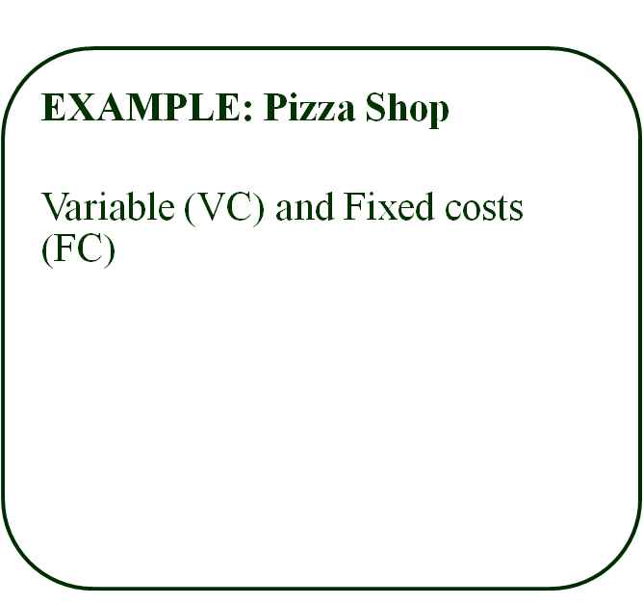
Fixed Costs |  | Variable Costs / unit
General Labor | $1,500 | Flour | $0.50
Rent | $3,000 | Yeast | $0.05
Insurance | $200 | Water | $0.01
Advertising | $500 | Cheese | $3.00
Utitilies | $450 | Pepperoni | $2.00
Total | $5,650 | Total | $5.56
© 2007 Prentice Hall, Inc. All rights reserved.
9–<number>

Slide 20
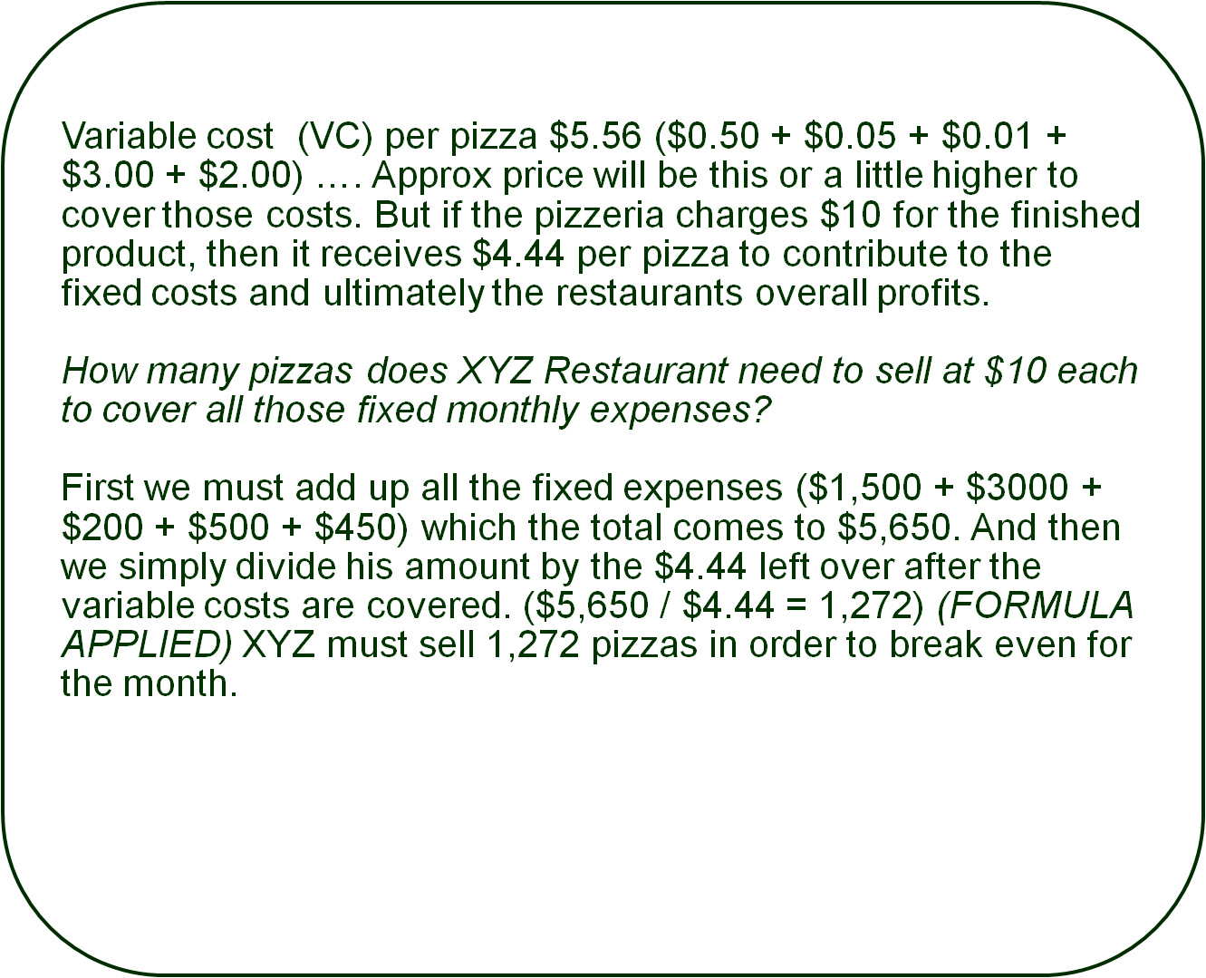
9–<number>

